Slide 1












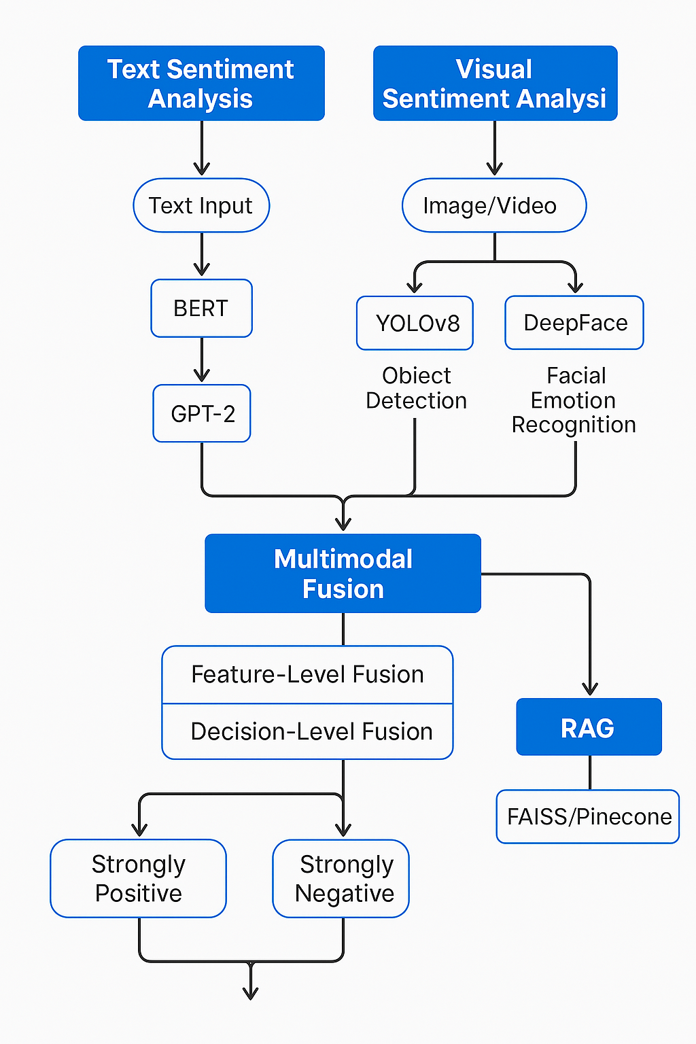

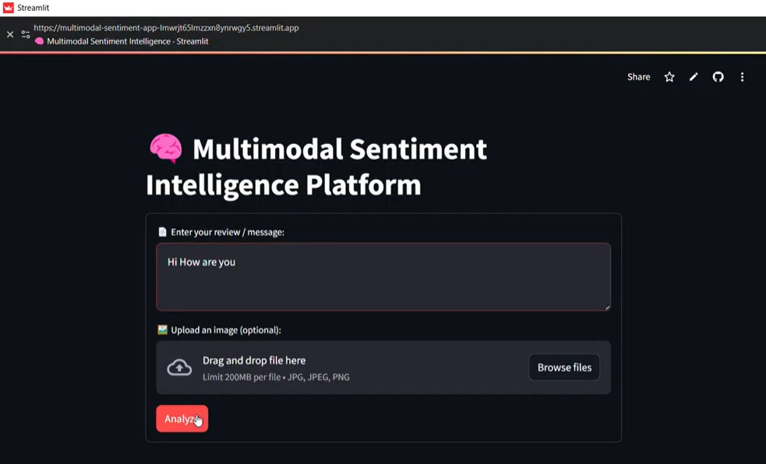
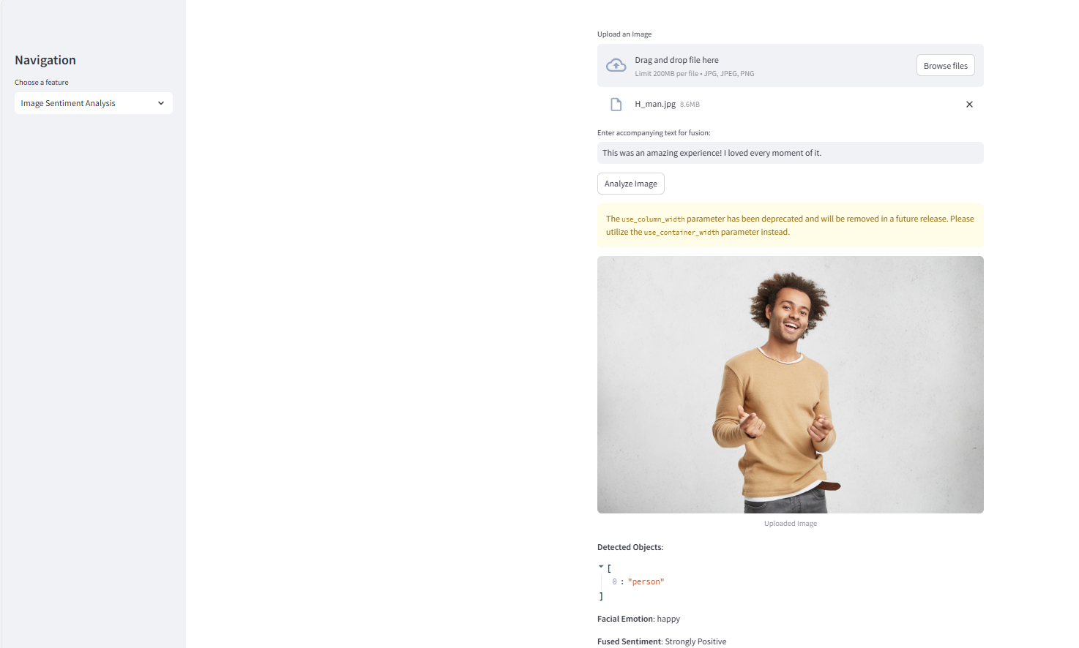

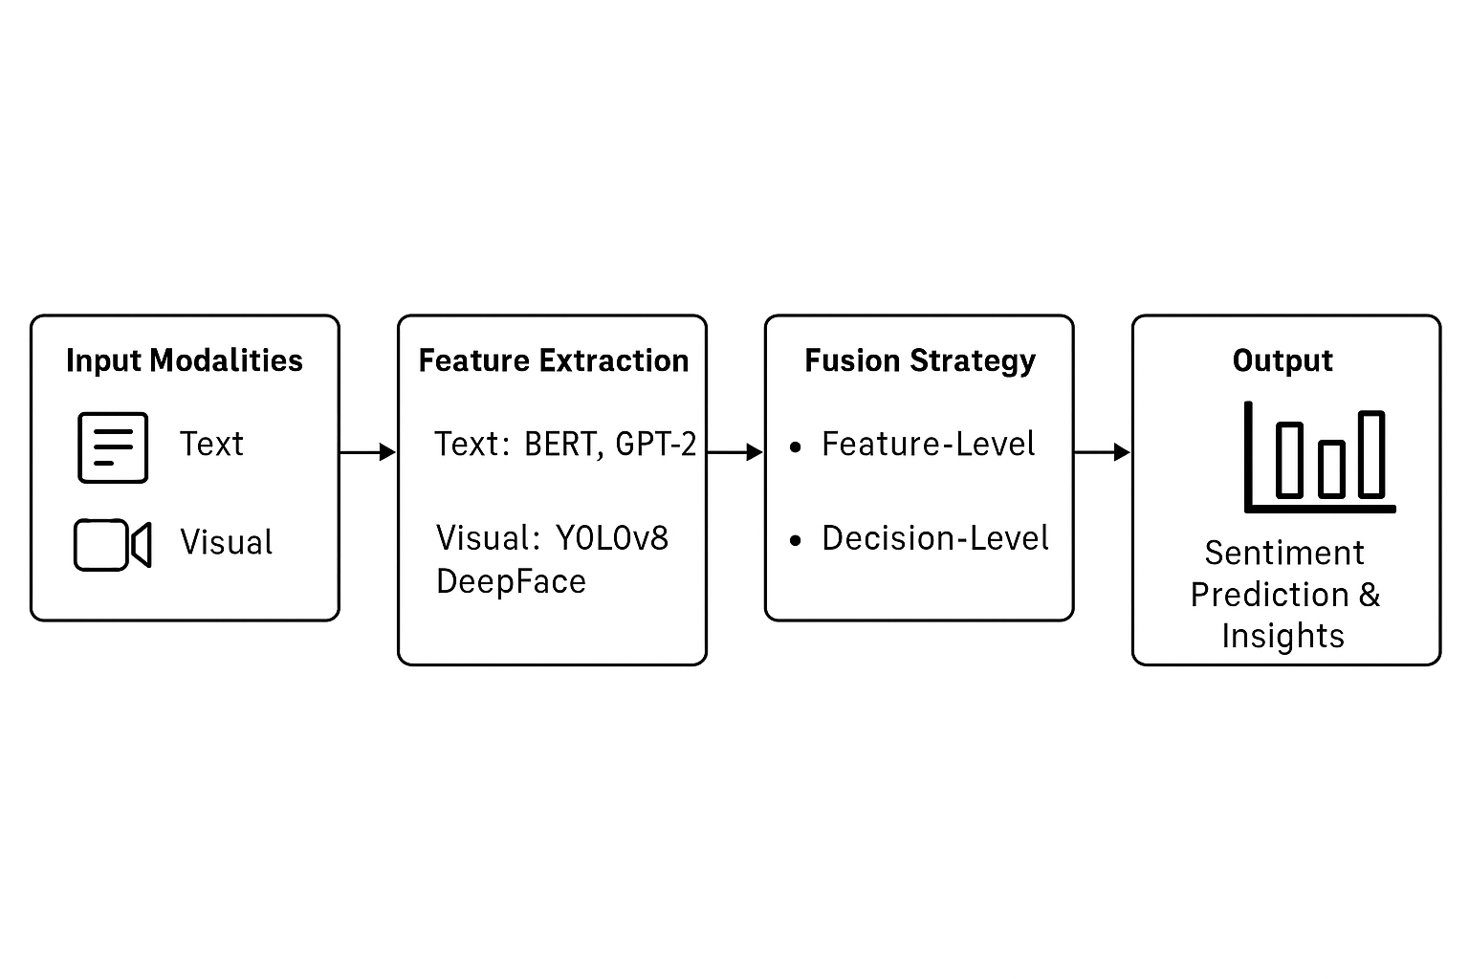
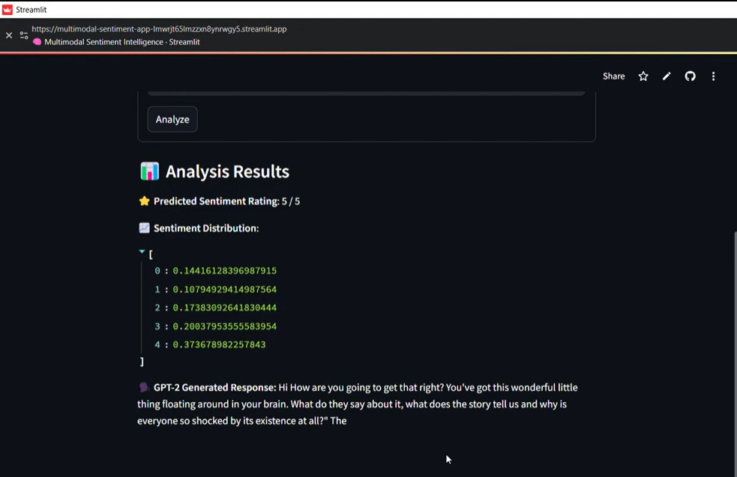
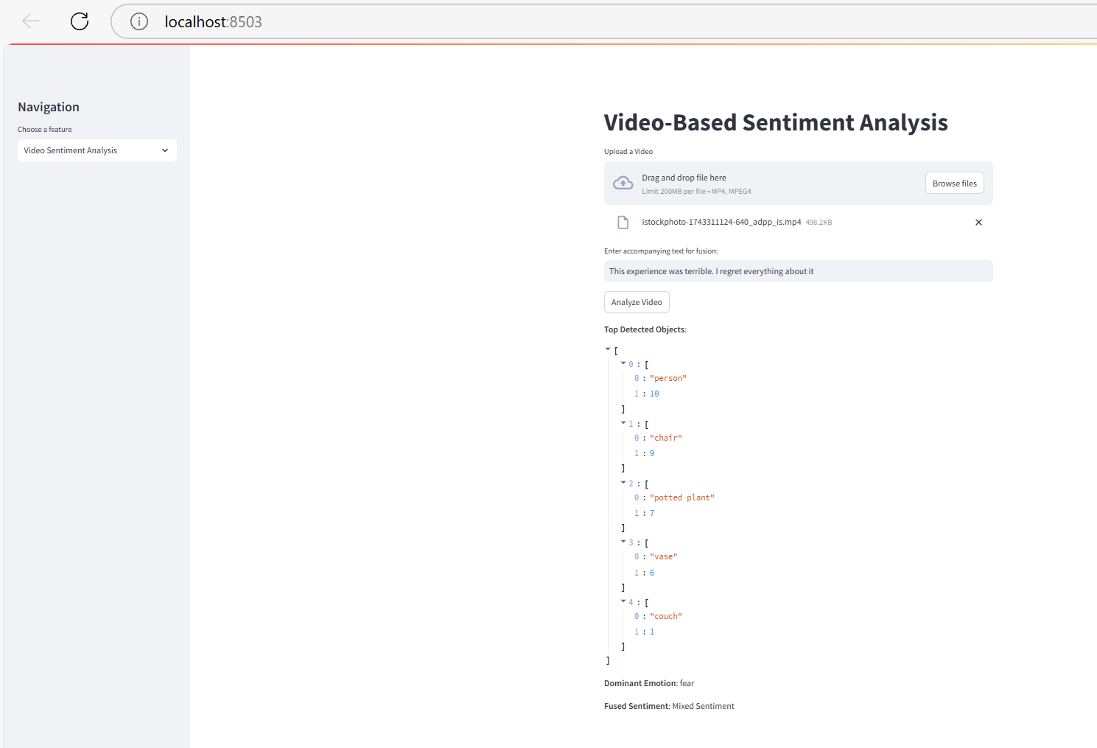





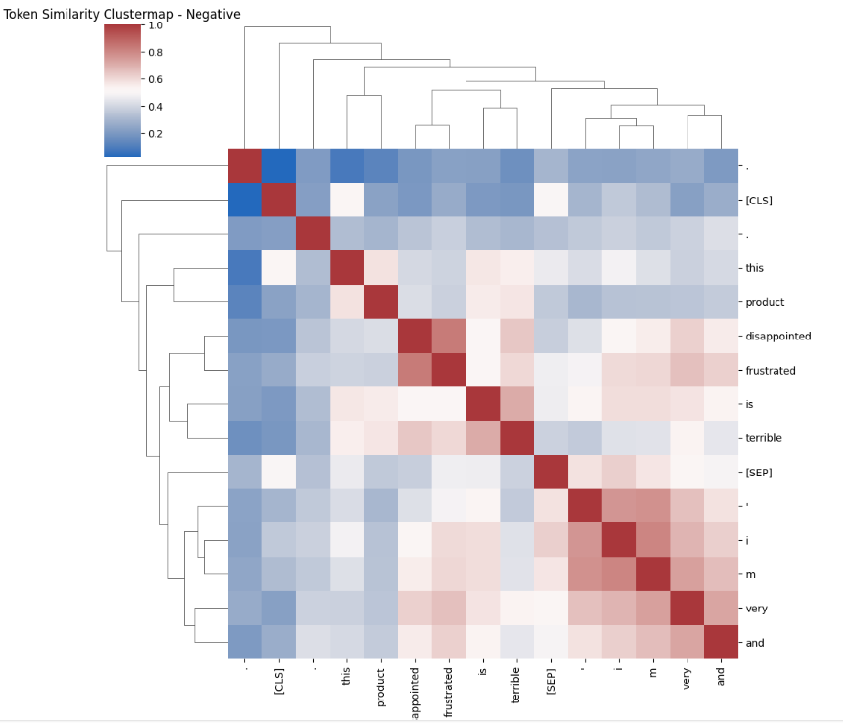
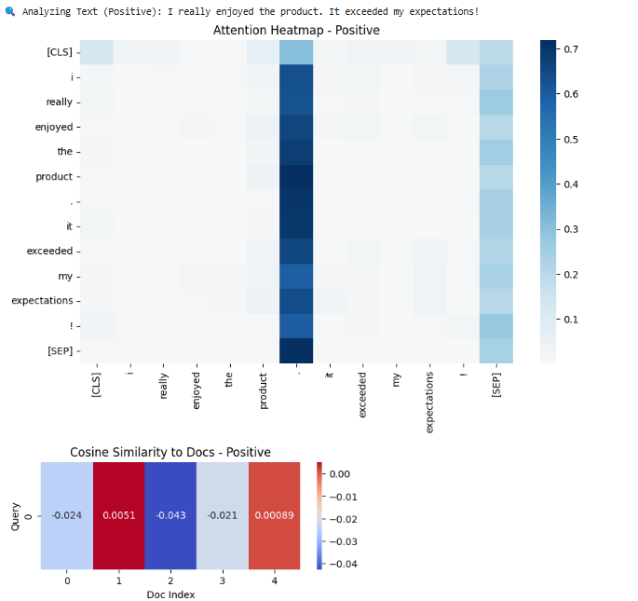
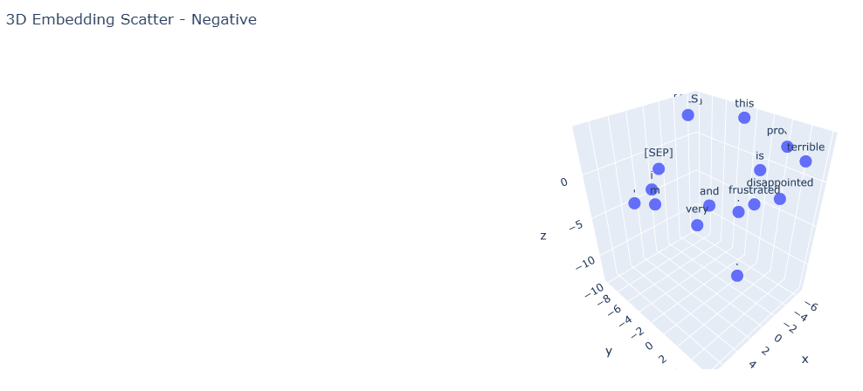







Multimodal Sentiment Intelligence Platform for Dynamic Market Insights
Computer Science
Vinay Viswanadh Alli, Apurva Vadlakonda, Shivanjali Dyapa and Divya Mishra
Context
Multi-modal Methodology
Visualization
Multimodal Sentiment Intelligence Platform, integrates text and visual data for real-time market insights. It leverages BERT/GPT-2 for text sentiment, YOLOv8 & DeepFace for visual sentiment, and fusion strategies (feature & decision-level) to enhance accuracy. CMU-MOSEI is used for multimodal sentiment training. The system is deployable via Streamlit, FastAPI, or cloud platforms for business intelligence in marketing, finance, and customer service.
Text Sentiment Analysis
Uses BERT for classification and GPT-2 for explanation.
Trained on IMDb, Amazon Reviews, CMU-MOSEI datasets.
Predicts sentiment (Positive/Negative) from text input.
Visual Sentiment Analysis
Uses YOLOv8 for object detection and DeepFace for facial emotion recognition.
Analyzes images/videos to detect objects and dominant emotions.
Trained on CMU-MOSEI, AffectNet, FER-2013.
Multimodal Fusion
Feature-Level Fusion: Combines text and visual embeddings.
Decision-Level Fusion: Merges predictions using ensemble methods.
Outputs Strongly Positive, Strongly Negative, or Mixed Sentiment.
RAG (Retrieval-Augmented Generation)
Uses FAISS/Pinecone to fetch relevant context.
Enhances sentiment predictions with external knowledge.
Visualization
Includes attention heatmaps, cosine similarity, PCA + KMeans, and
3D scatter plots for deeper insights.
Our platform provides a real-time sentiment analysis dashboard, integrating insights from text and visual data. The results are displayed through an interactive web interface, showcasing sentiment trends, classifications, and feature-based insights.
Background
Understanding market sentiment in real-time is critical for businesses to make informed decisions. Traditional sentiment analysis methods focus primarily on text-based analysis, often missing crucial visual and contextual cues. However, human sentiment is multimodal, expressed not just through words but also through facial expressions, tone, and visual context. Recent advancements in Deep Learning, Large Language Models (LLMs), and Multimodal Fusion enable AI to analyze sentiment across multiple modalities. CMU-MOSEI, a large-scale multimodal dataset, provides labeled video data with sentiment and emotion annotations, allowing models to learn from diverse real-world expressions. By integrating BERT/GPT-2 (text sentiment), YOLOv8 (object detection), DeepFace (facial emotion recognition), and Retrieval-Augmented Generation (RAG), this project aims to develop an AI-driven sentiment intelligence platform that delivers accurate, real-time market insights across industries like marketing, finance, and customer service.
Fig 2: Real-time Sentiment Analysis Dashboard: A web-based interface displaying sentiment predictions from text and visual data.
Dataset
Fig 1 : Multimodal Sentiment Intelligence Workflow: From Input (Text, Image, Video) to Processing (AI Models & Fusion) to Final Sentiment Analysis Display on Web Interface.
We utilize multiple datasets to train and evaluate our multimodal sentiment analysis model:
Results & Graphs
1.CMU-MOSEI (Carnegie Mellon Multimodal Opinion Sentiment and Emotion
Intensity)
Largest dataset for sentence-level multimodal sentiment analysis. Contains over 12 hours of annotated videos from 1000+ speakers across 250 topics. Provides text, visual, and audio modalities, enabling robust sentiment recognition.
Fig 3: Sentiment Analysis Output: Predicted sentiment classifications with insights derived from multimodal AI processing.
2.Amazon & IMDb Reviews (For Text Sentiment Analysis)
Large-scale textual datasets with labeled positive, neutral, and negative sentiment. Used to fine-tune BERT and GPT-2 for sentiment classification.
Discussion & Future Work
3.AffectNet / FER-2013 (For Facial Emotion Recognition)
Discussion & Future Work
Large datasets containing images labeled with facial expressions (happy, sad, angry, etc.). Helps train DeepFace for emotion detection in video sentiment analysis.
Our Multimodal Sentiment Intelligence Platform effectively integrates text and visual data to enhance sentiment analysis accuracy. By leveraging BERT, GPT-2, YOLOv8, and DeepFace, the system can extract meaningful insights from multiple modalities. The use of feature-level and decision-level fusion improves overall sentiment prediction, making the platform valuable for industries. However, certain limitations persist, such as misinterpretation of sarcasm, low-quality input data, and bias in data. Future improvements aim to refine the system for better efficiency, accuracy, and scalability. Advanced attention-based fusion techniques can improve alignment between text and visual modalities, while lighter, optimized deep learning models will enhance real-time performance. Expanding the dataset to include diverse cultural and linguistic contexts can help reduce bias and improve generalization. The long-term goal is to deploy this platform at scale for applications in social media monitoring, brand sentiment tracking, and financial forecasting.
References
[1]Das, Ringki, and Thoudam Doren Singh. "Multimodal sentiment analysis: a survey of methods, trends, and challenges." ACM Computing Surveys 55.13s (2023): 1-38. [2] Miah, Md Saef Ullah, et al. "A multimodal approach to cross-lingual sentiment analysis with ensemble of transformer and LLM." Scientific Reports 14.1 (2024): 9603. [3] Liu, Zhicheng, et al. "Ensemble pretrained models for multimodal sentiment analysis using textual and video data fusion." Companion Proceedings of the ACM Web Conference 2024. 2024. [4] Alam, Md Jahangir, et al. "Advancements in Multimodal Social Media Post Summarization: Integrating GPT-4 for Enhanced Understanding." 2024 IEEE 48th Annual Computers, Software, and Applications Conference (COMPSAC). IEEE, 2024.

